Slide 1
Architectures in Context
Software Architecture
Lecture 2

Slide 2
Fundamental Understanding
Architecture is a set of principal design decisions about a software system
Three fundamental understandings of software architecture
  Every application has an architecture
  Every application has at least one architect
  Architecture is not a phase of development

Slide 3
Wrong View: Architecture as a Phase
  Treating architecture as a phase denies its foundational role in software development
  More than “high-level design”
  Architecture is also represented, e.g., by object code, source code, …

Slide 4
Context of Software Architecture
Requirements
Design
Implementation
Analysis and Testing
Evolution
Development Process

Slide 5
Requirements Analysis
Traditional SE suggests requirements analysis should remain unsullied by any consideration for a design
However, without reference to existing architectures it becomes difficult to assess practicality, schedules, or costs
  In building architecture we talk about specific rooms…
  …rather than the abstract concept “means for providing shelter”
In engineering new products come from the observation of existing solution and their limitations

Slide 6
New Perspective on Requirements Analysis
Existing designs and architectures provide the solution vocabulary
Our understanding of what works now, and how it works, affects our wants and perceived needs
The insights from our experiences with existing systems
  helps us imagine what might work and
  enables us to assess development time and costs
→ Requirements analysis and consideration of design must be pursued at the same time

Slide 7
Non-Functional Properties (NFP)
NFPs are the result of architectural choices
NFP questions are raised as the result of architectural choices
Specification of NFP might require an architectural framework to even enable their statement
An architectural framework will be required for assessment of whether the properties are achievable

Slide 8
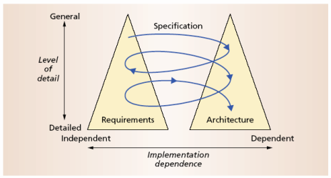
The Twin Peaks Model

Slide 9
Design and Architecture
Design is an activity that pervades software development
It is an activity that creates part of a system’s architecture
Typically in the traditional Design Phase decisions concern
  A system’s structure
  Identification of its primary components
  Their interconnections
Architecture denotes the set of principal design decisions about a system
  That is more than just structure

Slide 10
Architecture-Centric Design
Traditional design phase suggests translating the requirements into algorithms, so a programmer can implement them
Architecture-centric design
  stakeholder issues
  decision about use of COTS component
  overarching style and structure
  package and primary class structure
  deployment issues
  post implementation/deployment issues

Slide 11
Design Techniques
Basic conceptual tools
  Separation of concerns
  Abstraction
  Modularity
Two illustrative widely adapted strategies
  Object-oriented design
  Domain-specific software architectures (DSSA)

Slide 12
Object-Oriented Design (OOD)
Objects
  Main abstraction entity in OOD
  Encapsulations of state with functions for accessing and manipulating that state

Slide 13
Pros and Cons of OOD
Pros
  UML modeling notation
  Design patterns
Cons
  Provides only
    One level of encapsulation (the object)
    One notion of interface
    One type of explicit connector (procedure call)
      Even message passing is realized via procedure calls
  OO programming language might dictate important design decisions
  OOD assumes a shared address space

Slide 14
DSSA
Capturing and characterizing the best solutions and best practices from past projects within a domain
Production of new applications can focus on the points of novel variation
Reuse applicable parts of the architecture and implementation
Applicable for product lines
  →Recall the Philips Koala example discussed in the previous lecture

Slide 15
Implementation
The objective is to create machine-executable source code
  That code should be faithful to the architecture
    Alternatively, it may adapt the architecture
    How much adaptation is allowed?
    Architecturally-relevant vs. -unimportant adaptations
  It must fully develop all outstanding details of the application

Slide 16
Faithful Implementation
All of the structural elements found in the architecture are implemented in the source code
Source code must not utilize major new computational elements that have no corresponding elements in the architecture
Source code must not contain new connections between architectural elements that are not found in the architecture
Is this realistic?
Overly constraining?
What if we deviate from this?

Slide 17
Unfaithful Implementation
The implementation does have an architecture
  It is latent, as opposed to what is documented.
Failure to recognize the distinction between planned and implemented architecture
  robs one of the ability to reason about the application’s architecture in the future
  misleads all stakeholders regarding what they believe they have as opposed to what they really have
  makes any development or evolution strategy that is based on the documented (but inaccurate) architecture doomed to failure

Slide 18
Implementation Strategies
Generative techniques
  e.g. parser generators
Frameworks
  collections of source code with identified places where the engineer must “fill in the blanks”
Middleware
  CORBA, DCOM, RPC, …
Reuse-based techniques
  COTS, open-source, in-house
Writing all code manually

Slide 19
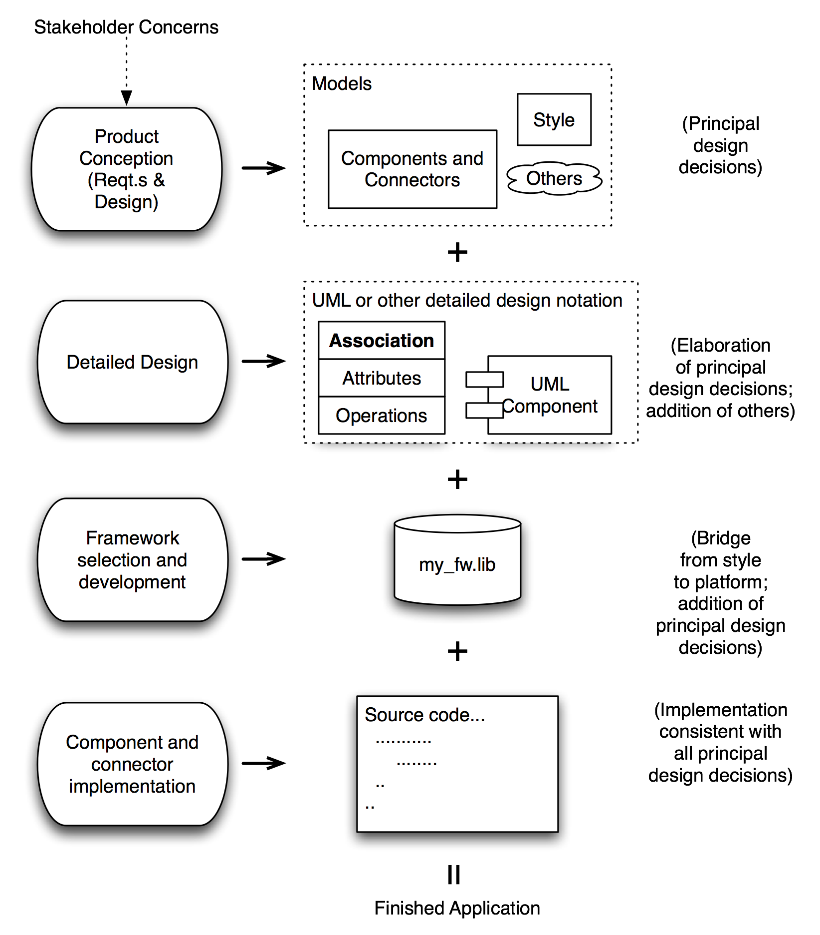
How It All
Fits
Together
Software Architecture: Foundations, Theory, and Practice; Richard N. Taylor, Nenad Medvidovic, and Eric M. Dashofy; © 2008 John Wiley & Sons, Inc. Reprinted with permission.

Slide 20
Analysis and Testing
Analysis and testing are activities undertaken to assess the qualities of an artifact
The earlier an error is detected and corrected the lower the aggregate cost
Rigorous representations are required for analysis, so precise questions can be asked and answered

Slide 21
Analysis of Architectural Models
Formal architectural model can be examined for internal consistency and correctness
An analysis on a formal model can reveal
  Component mismatch
  Incomplete specifications
  Undesired communication patterns
  Deadlocks
  Security flaws
It can be used for size and development time estimations

Slide 22
Analysis of Architectural Models (cont’d)
Architectural model
  may be examined for consistency with requirements
  may be used in determining analysis and testing strategies for source code
  may be used to check if an implementation is faithful

Slide 23
Evolution and Maintenance
All activities that chronologically follow the release of an application
Software will evolve
  Regardless of whether one is using an
  architecture-centric development process or not
The traditional software engineering approach to maintenance is largely ad hoc
  Risk of architectural decay and overall quality degradation
Architecture-centric approach
  Sustained focus on an explicit, substantive, modifiable, faithful architectural model

Slide 24
Architecture-Centric Evolution Process
Motivation
Evaluation or assessment
Design and choice of approach
Action
  includes preparation for the next round of adaptation

Slide 25
Processes
Traditional software process discussions make the process activities the focal point
In architecture-centric software engineering the product becomes the focal point
No single “right” software process for architecture-centric software engineering exists

Slide 26
Turbine – A New Visualization Model
Goals of the visualization
  Provide an intuitive sense of
    Project activities at any given time
      Including concurrency of types of development activities
    The “information space” of the project
  Show centrality of the products
    (Hopefully) Growing body of artifacts
    Allow for the centrality of architecture
      But work equally well for other approaches,
      including “dysfunctional” ones
  Effective for indicating time, gaps, duration of activities
  Investment (cost) indicators

Slide 27
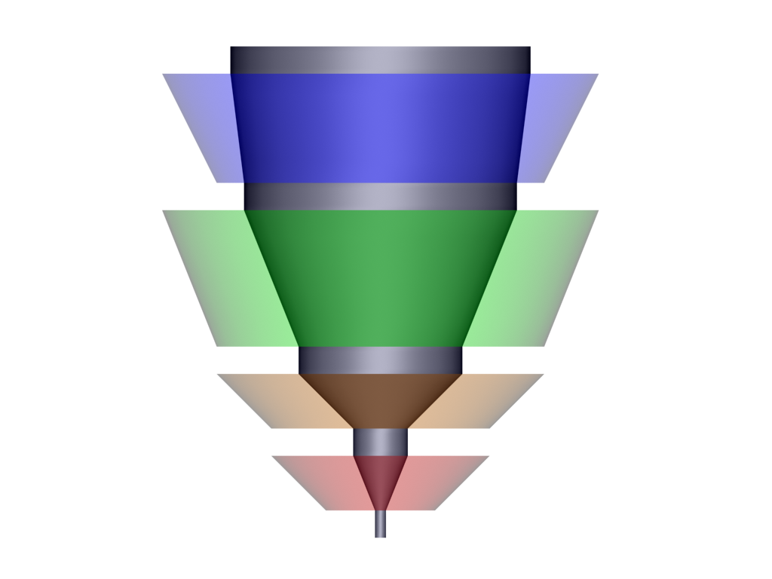
The Turbine Model
time
“Core” of project
artifacts
Testing
Gap between rotors
indicates no project
activity for that Δt
Coding
Radius of rotor indicates
level of staffing at time t
Design
t_{i}
Simplistic Waterfall,
Side perspective
Requirements
Software Architecture: Foundations, Theory, and Practice; Richard N. Taylor, Nenad Medvidovic, and Eric M. Dashofy; © 2008 John Wiley & Sons, Inc. Reprinted with permission.

Slide 28
Cross-section at time t_{i}
Design
(activity)
Requirements
Design
doc
Software Architecture: Foundations, Theory, and Practice; Richard N. Taylor, Nenad Medvidovic, and Eric M. Dashofy; © 2008 John Wiley & Sons, Inc. Reprinted with permission.

Slide 29
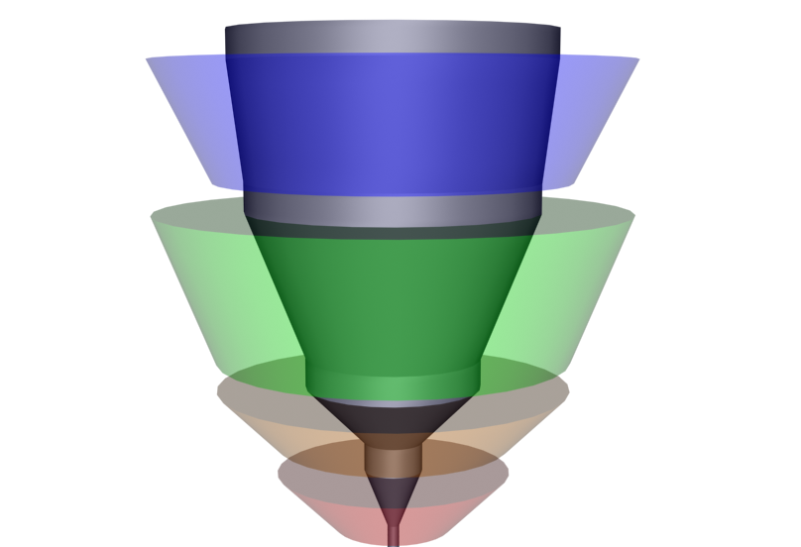
The Turbine Model
time
Waterfall example,
Angled perspective
Software Architecture: Foundations, Theory, and Practice; Richard N. Taylor, Nenad Medvidovic, and Eric M. Dashofy; © 2008 John Wiley & Sons, Inc. Reprinted with permission.
Notes:
Rotors are the activities.
Core are the artifacts.
Time goes upward.
Volume of rotor represents cost.
Volume of core represents information content.
Wide rotor represents lots of investment of (people) resources.

Slide 30

A Richer Example
Assess/…
time
Test/Build/
Deploy
Build/Design/
Requirements/Test
Design/Build/
Requirements
S₁
Requirements/Architecture
assessment/Planning
Software Architecture: Foundations, Theory, and Practice; Richard N. Taylor, Nenad Medvidovic, and Eric M. Dashofy; © 2008 John Wiley & Sons, Inc. Reprinted with permission.
Notes:
Rotor 1: Reqts 50%; Architecture assessment 30%; Project planning 20%.
Rotor 2: Design: 50%; Impl. 25%; Reqts 12.5%; Other 12.5%
Rotor 3: Design 15%; Impl. 50%; A&T: 25%; Reqts 5%; Other 5%
Rotor 4: Impl. 15%, A&T 50%; Deployment 20%; Other 15%
Rotor 5: Analysis of lessons learned: 85%; Other 15%
GAP rotor (i.e. some amount of the core sticks out above the top rotor

Slide 31
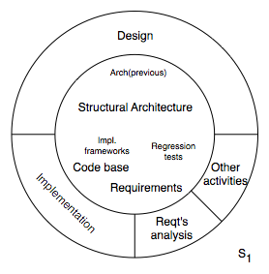
A Sample Cross-Section
Software Architecture: Foundations, Theory, and Practice; Richard N. Taylor, Nenad Medvidovic, and Eric M. Dashofy; © 2008 John Wiley & Sons, Inc. Reprinted with permission.

Slide 32
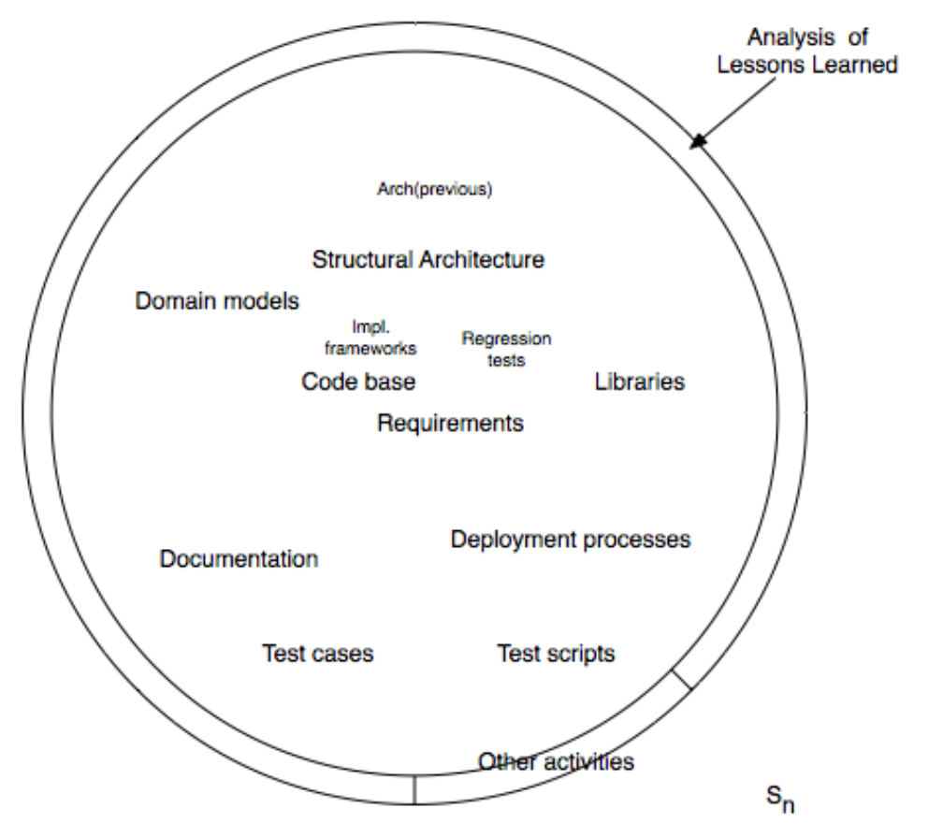
A Cross-Section at Project End
Software Architecture: Foundations, Theory, and Practice; Richard N. Taylor, Nenad Medvidovic, and Eric M. Dashofy; © 2008 John Wiley & Sons, Inc. Reprinted with permission.

Slide 33
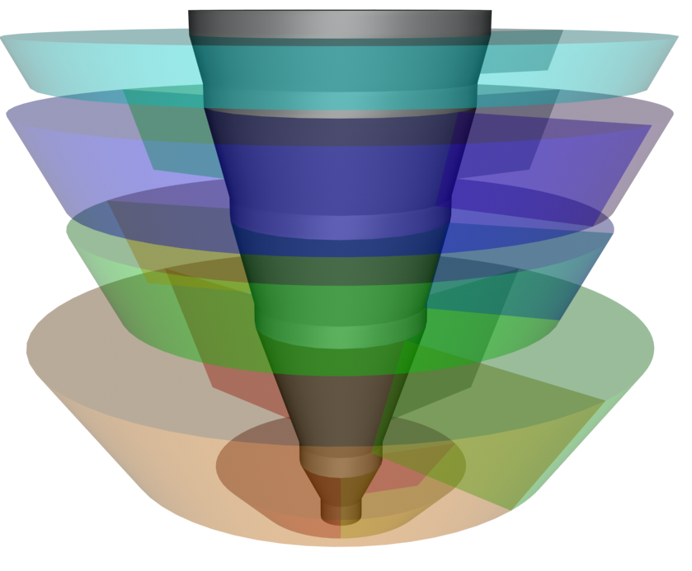
Volume Indicates Where Time was Spent
Assess/…
Test/Build/
Deploy
Build/Design/
Requirements/Test
Design/Build/
Requirements
Requirements/
Architecture Assessment / Planning
Software Architecture: Foundations, Theory, and Practice; Richard N. Taylor, Nenad Medvidovic, and Eric M. Dashofy; © 2008 John Wiley & Sons, Inc. Reprinted with permission.
Notes:
Rotor 1: Reqts 50%; Architecture assessment 30%; Project planning 20%.
Rotor 2: Design: 50%; Impl. 25%; Reqts 12.5%; Other 12.5%
Rotor 3: Design 15%; Impl. 50%; A&T: 25%; Reqts 5%; Other 5%
Rotor 4: Impl. 15%, A&T 50%; Deployment 20%; Other 15%
Rotor 5: Analysis of lessons learned: 85%; Other 15%
GAP rotor (i.e. some amount of the core sticks out above the top rotor

Slide 34
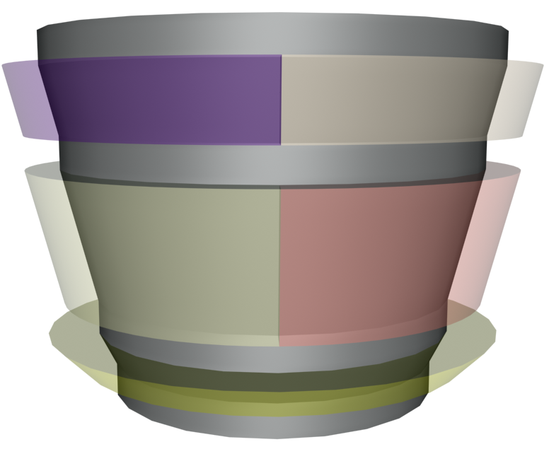
A Technically Strong Product-Line Project
Deployment
Capture of new work
Other
Parameterization
Customization
Assessment
Software Architecture: Foundations, Theory, and Practice; Richard N. Taylor, Nenad Medvidovic, and Eric M. Dashofy; © 2008 John Wiley & Sons, Inc. Reprinted with permission.
Notes:
Lots of substance coming in.
Small volume (cost) in the rotors.
Rotor 1: Assessment: 100%
Rotor 2: Parameterization: 50% Customization: 50
Rotor 3: Deployment: 50 Capture: 30 Other: 20
Capture is the work to take what was customization here and package it so that it is reusable in future projects.

Slide 35
Visualization Summary
It is illustrative, not prescriptive
It is an aid to thinking about what’s going on in a project
Can be automatically generated based on input of monitored project data
Can be extended to illustrate development of the information space (artifacts)
  The preceding slides have focused primarily on the development activities

Slide 36
Processes Possible in this Model
Traditional, straight-line waterfall
Architecture-centric development
DSSA-based project
Agile development
Dysfunctional process

Slide 37
Summary (1)
A proper view of software architecture affects every aspect of the classical software engineering activities
The requirements activity is a co-equal partner with design activities
The design activity is enriched by techniques that exploit knowledge gained in previous product developments
The implementation activity
  is centered on creating a faithful implementation of the architecture
  utilizes a variety of techniques to achieve this in a cost-effective manner

Slide 38
Summary (2)
Analysis and testing activities can be focused on and guided by the architecture
Evolution activities revolve around the product’s architecture.
An equal focus on process and product results from a proper understanding of the role of software architecture

